Slide 1
Project title – Instagram User Analytics
Project Description :-
This project is based on queries raised by the product team of Instagram on various issues.
The following queries were raised by the marketing team :-
People who have been using platform for the longest time.
Who are the inactive users.
Which user has got the most likes on a photo.
Which are the most popular hashtags on Instagram.
Which is the best day to launch Ads.
The following queries were raised by the investors :-
How active are users on Instagram
Is Instagram crowded with fake and dummy accounts.

Slide 2
Approach –
We have got a dataset which contains many tables that contain information regarding various fields creating log of user activities. We went through the dataset closely and then executed various queries to extract the required data from the table.
Tech/Tools used –
We used below mentioned tools to perform the analysis :-
SQL - To run the Query and extract data from database.
PPT – To prepare a detailed report on the observations based on the data received.

Slide 3
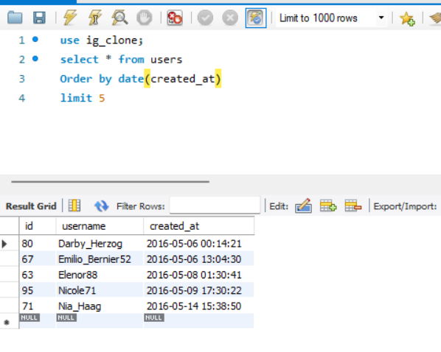
Insights –
We ran the query and recorded our observations based on the questions as asked by them in serial order.
1. People who have been using Instagram for the longest time.

Slide 4
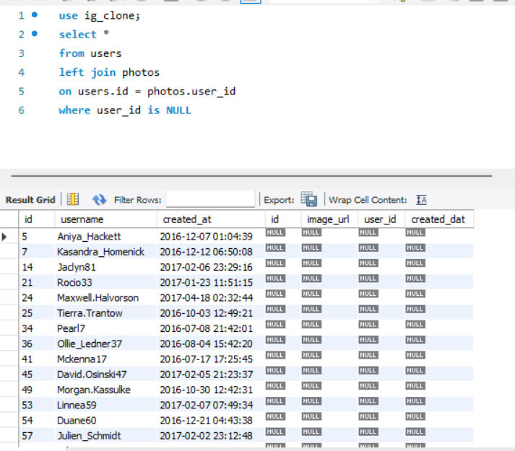
2. Who are the inactive users (those who have never posted any photo).

Slide 5
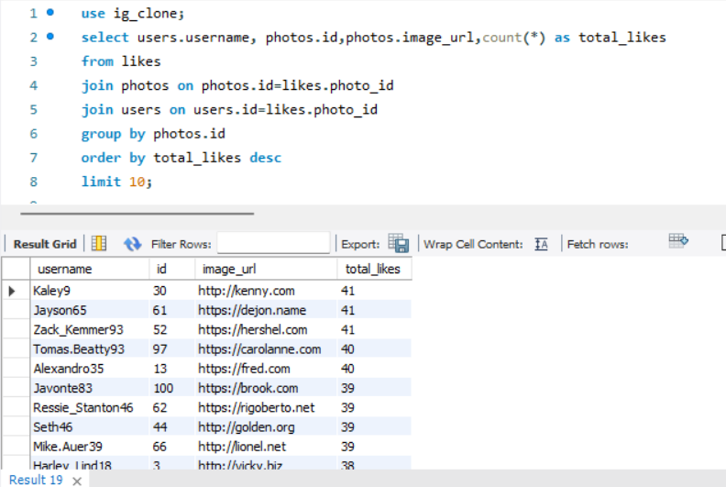
3. Which user has got the most likes on a photo .

Slide 6
4. Which are the most popular hashtags on Instagram. -- unable to solve..need help

Slide 7
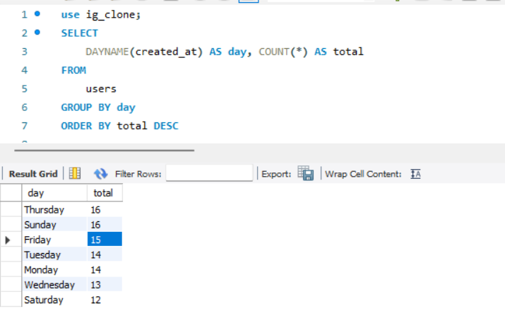
5. Which is the best day to launch Ads.

Slide 8
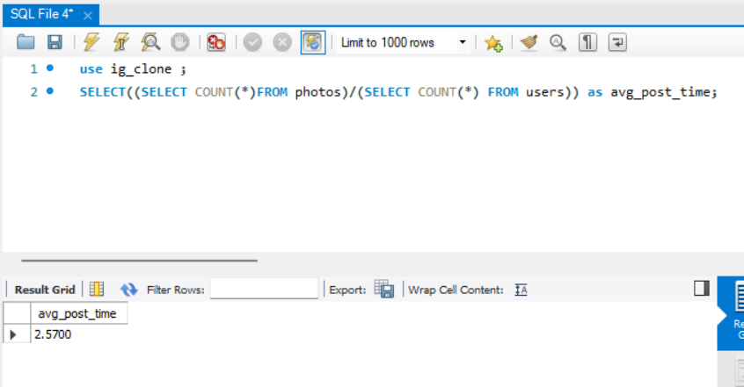
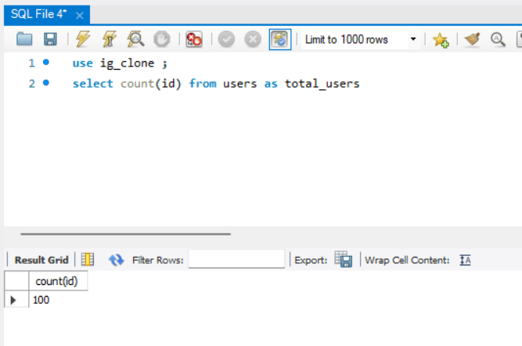
6. How active are users on Instagram
Total users on Instagram

Slide 9
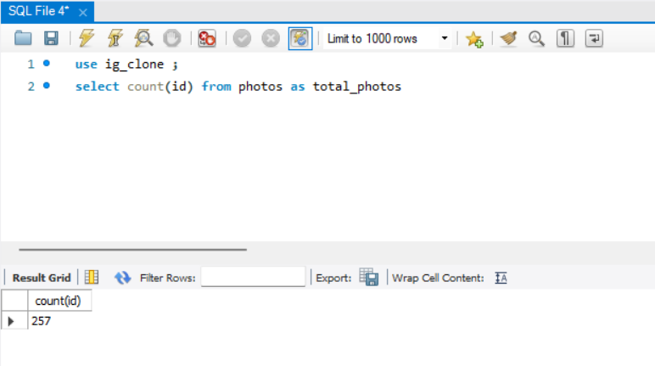
Total number of photos

Slide 10
7. Is Instagram crowded with fake and dummy accounts.

Slide 11
RESULTS :-
The following results can be obtained after running the queries –
1. People who have been using platform for the longest time.
Ans - Id Username
80 Darby_Herzog
67 Emilio_Bernier52
63 Elenor88
95 Nicole71
71 Nia_Haag
2. Who are the inactive users.
Ans – There are around 26 inactive users who have not yet posted a single photo. The details are mentioned in excel file
attached here.
3. Which user has got the most likes on a photo.
Ans – 3 users have got most likes on a photo.
username id
Kaley9 30
Jayson65 61
Zack_Kemmer93 52

Slide 12
4. Which are the most popular hashtags on Instagram.
(unable to solve)
5. Which is the best day to launch Ads.
Ans – Thursday and Sunday are best day to launch Ads.
6. How active are users on Instagram
Ans – Average user posting time is 2.57
7. Is Instagram crowded with fake and dummy accounts.
(Unable to solve)
All complete values/data obtained after queries are present in excel attached below :-

